Slide 1
"Child labour in India and its effect on Development"
Group-6

Slide 2
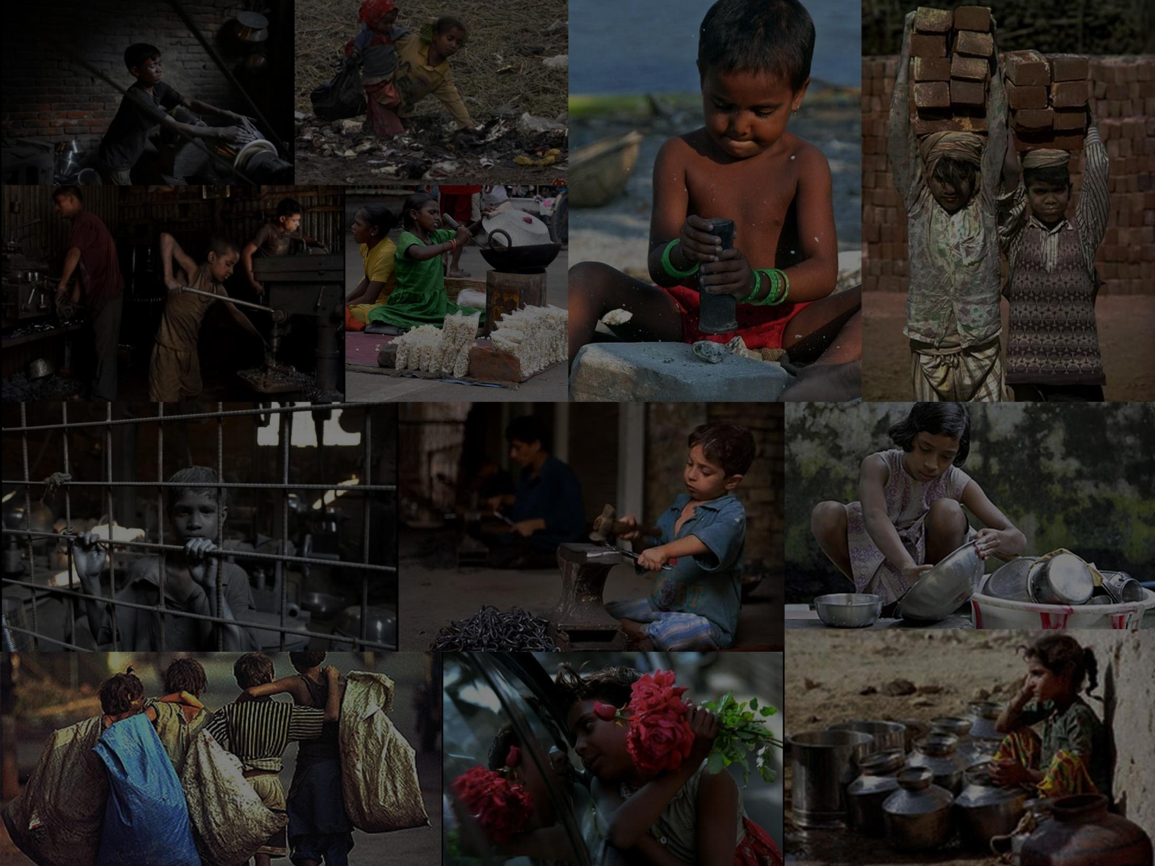
Children are future citizens of the Nation and their adequate development is at most priority of the country.

Slide 3
Content
What is Child Labour?
The main sectors where children are preferred for work
Factors triggering child labours
Statistics of child labour
The overall effect due to Child labour in a country
Case study on a project by ILO in Karnataka, India to decrease the exploitation of labourers
Role of Indian Government in combating child labour
Private Institutions and NGO’s against child labour
Case study on Sivakasi fireworks industry
True facts about Child Labour
Umme Rubab’s case analysis
Conclusion

Slide 4
Childhood
Childhood is considered to be one of the most enjoyable stage of life. But sadly it is not true for every child in the world.
They are considered adult-enough by their under-nourished and poverty-stricken families to work, once these children cross the age of nearly eight.
Though children of poor families may be bright and intelligent, they often do not get access to facilities to hone themselves professionally and achieve their potential.

Slide 5
What is Child Labour?
According to ILO(International Labour Organization):-
Child labour is defined as work that deprives children of their healthy childhood, their potential and their dignity, and that is harmful to physical and mental development and work whose schedule interferes with their ability to attend regular school.
And the children practicing this type of work are called child labourers.
According to Indian Law:-
Children who are engaged in labor work for economic gains, like harmful works or hazardous works in age of below14 years are called as child labourers.
Out of every 9 children 1 is a child labor today.

Slide 6
Where we see the child labours?
Agriculture-
Children working long hours and under severe hardships on the fields. They are also exposed to the hazards of working with modern machinery and chemicals.
Hazardous Industries/ Occupations-
Like glass making, mining, construction, carpet weaving, zari making, fireworks, etc.
Small industrial workshops and service establishments
On the streets
Rag pickers , porters ,vendors etc.
Domestic work
Hotels, dhabas, spas and restaurants

Slide 7
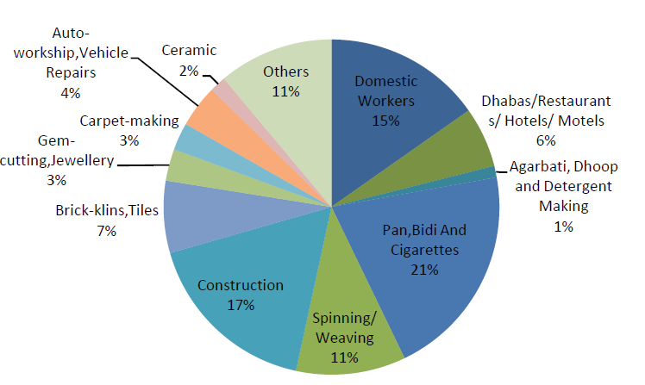
Child labour in India, Industry Wise(2001)
Note: Today this woud have definitely decreased due to measures taken by Govt of India, but these figures are to give rough idea about distribution of child labour in different sectors.

Slide 8
Factors triggering child labour
High poverty and unemployment levels
Intense poverty forces many children to become child labourers
Limited access to education
In 2006, approximately 75 million children were not in school
Achieving universal education for the world's children would cost $10-30 billion -- about 0.7% - 2.0% of the annual cost of global military spending.
Inadequate law and enforcement
Labor departments and labor inspection offices are often under-funded and under-staffed, or courts may fail to enforce the laws
Many state governments allocate few resources to enforcing child labor laws.
Tradition
Many parents engage their children to the traditional business and profession.
The most familiar example is bangle industries in India.
Notes:
Simply making primary education free and compulsory is not the all-out option. Ensuring its delivery is the important aspect.

Slide 9
Contd.
National laws often include exemptions on Child Labour
Nepal
Plantations and brick kilns are exempt
Kenya
Excludes agriculture
Bangladesh
Sets no regulations on domestic work or agricultural work
Parental Illiteracy
Literacy can make a huge difference by helping them understand the importance of education in one’s life.
Overpopulation
Creates unemployment and the ultimate result is poverty.
Unemployment of elders forces the child to work and earn bread for family
Orphanage

Slide 10
Statistics

Slide 11
Total % of children in the World population

Slide 12
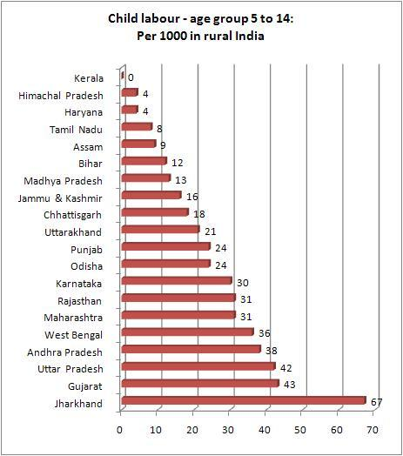
State wise statistics of Child Labour in India

Slide 13
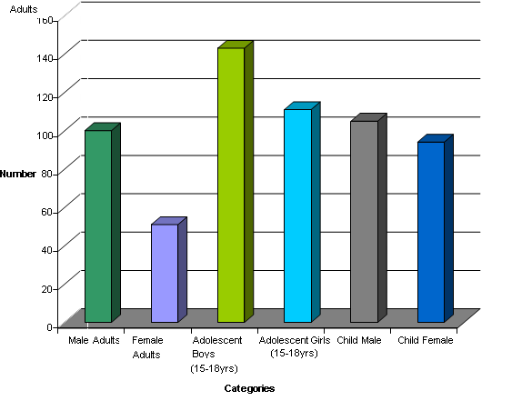
Gender wise classified statistics of labour in India
In thousands

Slide 14
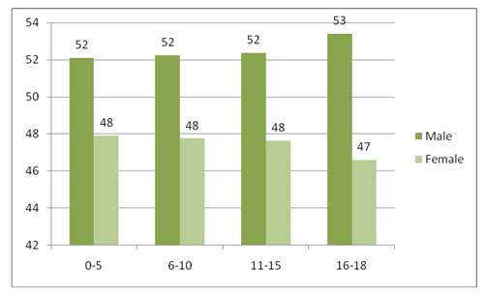
Gender-cum-Age wise classified statistics

Slide 15
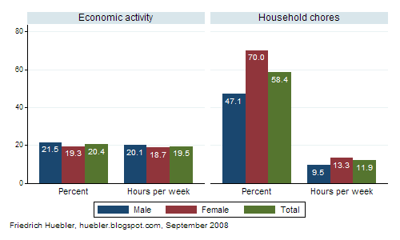
Gender-cum-Activity wise classified statistics
Household is the first choice for the child labour the main reason behind that is no risk

Slide 16
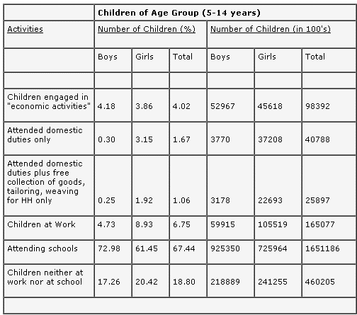
Gender-cum-Activity wise classified statistics

Slide 17
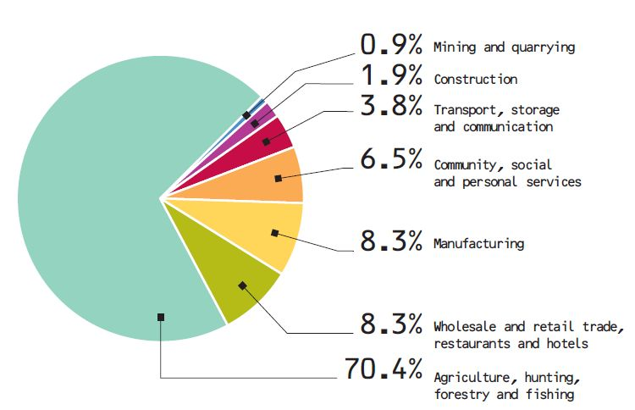
Activity wise classified statistics

Slide 18
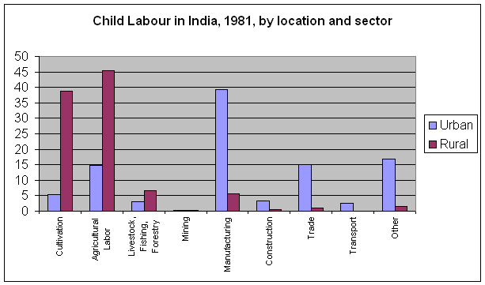
Activity wise classified statistics

Slide 19
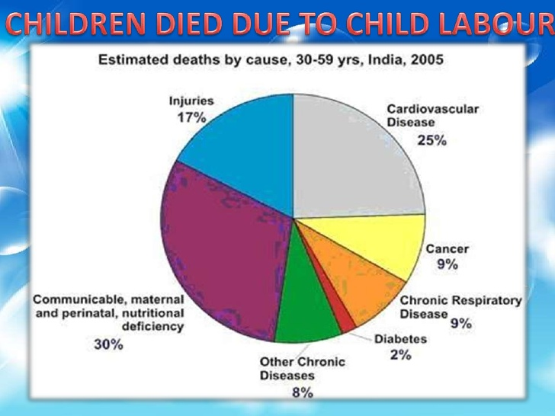
Children death statistics

Slide 20
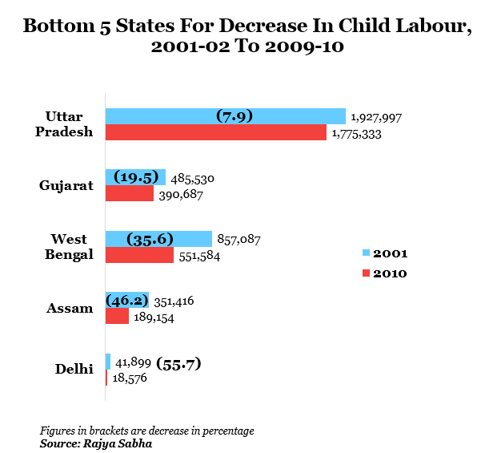
Ending on a slightly good note

Slide 21
Effects of Child labour on Economic Development
*Due to lack of proper numerical data on this field we did mostly qualitatively analysis on this topic

Slide 22
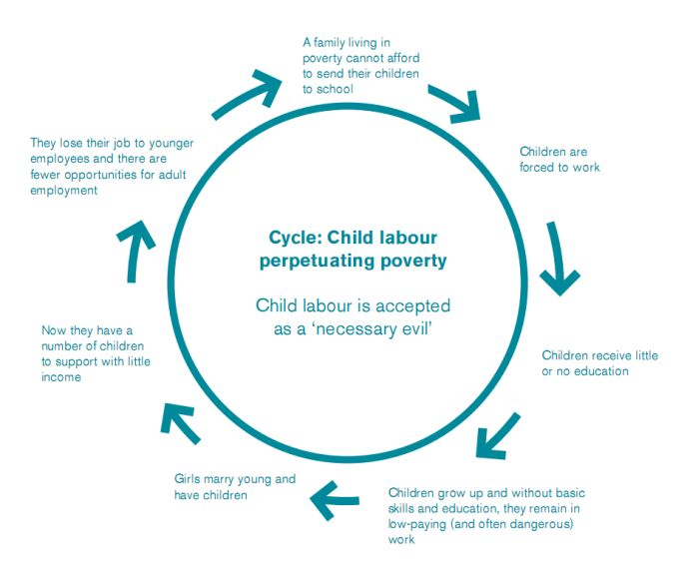
Perpetual Cycle of Child Labour

Slide 23
Micro family level
Short term:-
It increases households’ income and probability of survival.
Since the poverty is main source of child labour, increasing latter factor decreases the poverty.
Long Term:-
It perpetuates household poverty through lower human capital accumulation
Since the child labour cannot attend school, he/she gathers less human capital(Knowledge, Skill, …), it decreases the future earning capacity and productivity, thus lowers the wage of future family and increases the probability of sending his/her offspring to labour.
But also:-
Leaving child labour, does not always means the child will go to school and will accumulate human capital and participate in more economic growth.
Because after leaving labour, going to school should be affordable to family and also the should give proper education.
So, either both or one of the problem exist in areas where child labour is practiced.

Slide 24
Contd.
Child labour has a negative long run impact on the well being of the family also through increased fertility. Thus boost up the unwanted population increase in the country. Let’s see How:-
Child labour lowers the perceived cost of having children thereby boosting fertility.
Now, as family grows, Larger family size in turn fuels the need for the income provided by children, generates child labour supply and impedes the education of the future generation of parents.
Since parents’ lack of education is one of the most important determinants of high fertility, large families needing the income from child labour perpetuate over time.

Slide 25
Do you Know?
One of the basic conditions motivating Indian families to bear relatively large numbers of children in the late 1950’s(Thus increasing Indian Population) was the high return to the use of raw labour power of children compared to investments in skills obtained in schools.
Source:-
Rosenzweig, M.R. and Evenson, R. 1977. “Fertility, Schooling, and the Economic Contribution of Children in Rural India: an Econometric Analysis”, in Econometrica. Vol.45, No.5 (July), pp. 1065-1079

Slide 26
Macroeconomic Level
Child labour affects the adult labour market :-
If Child and Adult are substitutes of each other for a work, employers prefer to hire children rather than adults, because they have to pay less to children.
Child labour thus either increases adult unemployment or lower the adult wage rates
Which in turn forces adults to put their children to work generating a vicious circle.
Thus, it decreases the legal employment and at the same time it is also hindrance to production of skilled human resources for future, hence deteriorating the country.

Slide 27
Effects of Child labour on FDI:-
There is no known direct effect of Child labour on FDI, but some studies show that countries with high child labour have attracted very low FDIs, contrary to what we think that “High child labour attracts more FDI” due to lower labour cost.
One possible factors of low FDIs is the act passed in U.S. Congress during 1993. It stated that :-
“Adult workers in the United States and other developed countries should not have their jobs imperiled by imports produced by child labor in developing countries”

Slide 28
Contd.
Impacts of child labour on growth through human capital:-
Impedes children’s school attendance, proficiency and human capital accumulation.
Depresses a country’s labour productivity and growth in the long run.
Low education is associated with lack of awareness of rights and of democratization.
Negatively affects growth and social development.
Impact of child labour on growth through fertility
The impact of child labour on fertility observed at the family level translates into lower long run growth at the national level.
Enhances national birth rate directly and indirectly, and higher national fertility inflicts a well-known cost in terms of growth.
This two problem can be solved by providing better education and better employment to educated one.

Slide 29
Contd.
Impact of child labour on growth through health
Health problems to them who are working in hazardous activities, and the lower hygiene associated with scarce education translate in the long run into a less healthy and hence less productive adult labour force, subtracting from long run growth.
Health-focused public expenditure and educational programmes can benefit not only the health of the children directly involved but also the country’s long run growth rate through enhanced health and labour productivity.

Slide 30
Effects of Child labour on Technological Development

Slide 31
The availability of cheap, unskilled child labour in fact allows employers to avoid investing in fixed capital and upgrading production processes.
It dampens technological progress, labour productivity and output growth in the long run.
Only one Empirical study on this was did and was suggested that :-
The study was on Diamond and Fayed (1998) who estimate the elasticity of complementarily between child labour and capital for industrial Egypt in 1991.
They find that children’s wages would decrease by 0.9% as a result of a 1% increase in the used quantity of capital.
It says that the introduction of labour saving devices negatively impacts market opportunities for underage workers and vice versa.

Slide 32
Effects of Child labour on Social Development

Slide 33
Effects on income inequality
Distribution of income becomes more unequal by depressing the wage rate of unskilled adults.
Affects the income of the involved families and of their descendants through mutually reinforcing low education and high fertility.
Indirectly reduces country’s level social development.

Slide 34
Effects on gender inequality
The conclusion from some papers* shows following:-
To the extent that girls are engaged more than boys in working activities, child labour can be a cause for gender inequality in education. This could happen for two reasons:-
If girls work longer hours than boys, it is more difficult for them to combine work and school attendance, and if they do, it is more likely for them to under-perform and drop out of school.
If girls work more than their brothers, the parents face a higher opportunity cost of educating girls than boys, reducing the probability of girls attending school.
And thus, gender biased child labour imposes constraints on a country’s long-run economic growth and social development.
King, E.M. and Hill, M.A. 1995. (Eds.): Women’s education in Developing Countries. Barriers, Benefits, and Policies.
The Johns Hopkins University Press, Baltimore and London.
Knaul, F.M. 1995. “Young Workers, Street Life and Gender: The Effect of Education and Work Experience on Earnings
in Colombia”. Unpublished PhD dissertation, Harvard University, Department of Economics.
Chaudri, D.P. 1997. “A Policy Perspective on Child Labour in India with Pervasive Gender and Urban Bias in School
Education”, in The Indian Journal of Labour Economics. Vol. 40, No. 4, pp. 789-808.

Slide 35
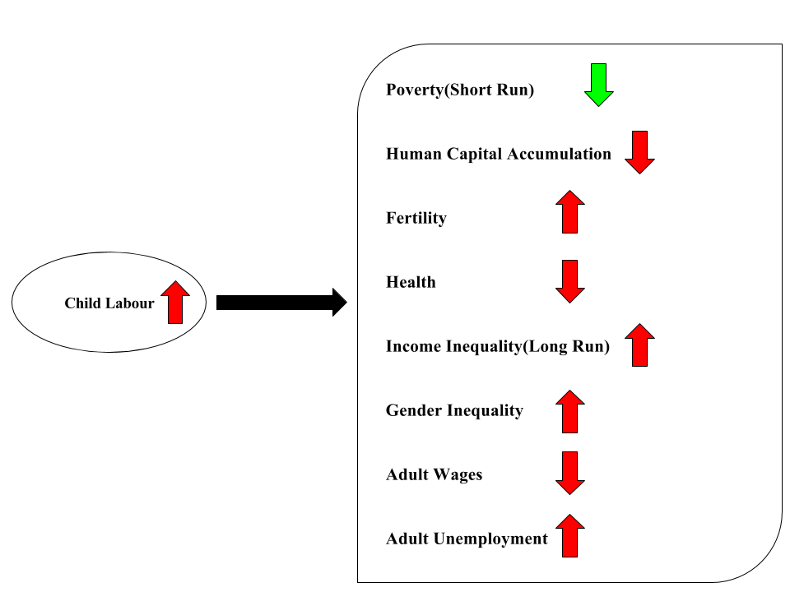
Summary
Then
If

Slide 36
Case Study
A project by ILO in Karnataka, India to decrease the exploitation of Labourers.

Slide 37
Aim and Background
The project was implemented in Bidar, District of Karnataka in the year 2008.
The project was aimed to discourage the practice of child labour and instead send them to School, prevent the exploitation of workers by middlemen, and improve socioeconomic conditions of the workers

Slide 38
Action
Some 1000 workers were gathered from the local working site and were grouped to form a worker’s cooperative society.
The Society was named “Bidar District Services of Labour Multipurpose Co-operative Society”
This society was founded for the purpose of providing decent employment and has its own service rules and by laws.

Slide 39
Effects
The cooperative society replaced the labour contractor who used to exploit the workers.
Instead the society itself approached to employers to find the contract.
This created transparency in appointments and the entire contract amount collected from the employer reached the workers.
Furthermore, it provided members with provident fund benefits as well as health insurance through the Ministry of Labour’s newly-introduced scheme.

Slide 40
Achievements
Currently all the workers who have become members of this cooperative are earning wages of up to Rs. 3,000 and are also part of the social security schemes.
The major effect was that this made the members to afford the school expenditure for their children and send them to school and get them out from labour.

Slide 41
Role of Indian Government in Combating Child Labour

Slide 42
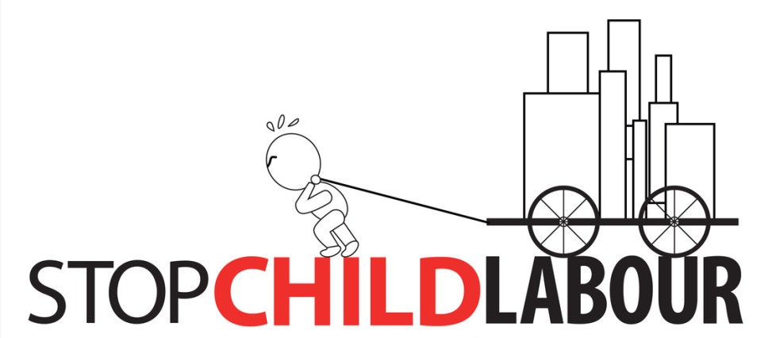
Fight Against Child Labour in India
The problem of child labour in India is so huge that it demands support and contribution from every part of society to completely eradicate this problem.
In recent times, government and some private institutions have taken some concrete steps for improving the situations of child labourers.

Slide 43
National Legislation and Policies Against Child Labour in India
Child labour is a matter on which both the Union Government and state governments can legislate. A number of legislative initiatives have been undertaken at both levels. The major national legislative developments include the following:
The Child Labour (Prohibition and Regulation) Act, 1986:The Act prohibits the employment of children below the age of 14 years in 16 occupations and 65 processes that are hazardous to the children's lives and health. These occupations and processes are listed in the Schedule to the Act. In October 2006, the Government has included children working in the domestic sector as well as roadside eateries and motels under the prohibited list of hazardous occupations. More recently, in September 2008 diving as well as process involving excessive heat (e.g. working near a furnace) and cold; mechanical fishing; food processing; beverage industry; timber handling and loading; mechanical lumbering; warehousing; and processes involving exposure to free silica such as slate, pencil industry, stone grinding, slate stone mining, stone quarries as well as the agate industry were added to the list of prohibited occupations and processes.

Slide 44
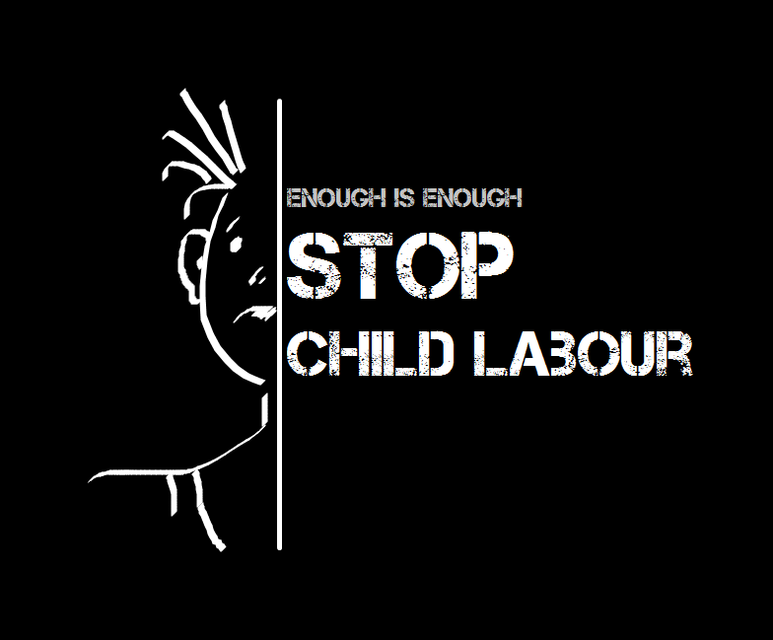
The Factories Act, 1948: The Act prohibits the employment of children below the age of 14 years. An adolescent aged between 15 and 18 years can be employed in a factory only if he obtains a certificate of fitness from an authorized medical doctor. The Act also prescribes four and a half hours of work per day for children aged between 14 and 18 years and prohibits their working during night hours.
The Mines Act, 1952: The Act prohibits the employment of children below 18 years of age in a mine. Further, it states that apprentices above 16 may be allowed to work under proper supervision in a mine.

Slide 45

The Juvenile Justice (Care and Protection) of Children Act, 2000: This Act was last amended in 2002 in conformity with the UN Convention on the Rights of the Child covers young persons below 18 years of age. Section 26 of this Act deals with the Exploitation of a Juvenile or Child Employee, and provides in relevant part, that whoever procures a juvenile or the child for the purpose of any hazardous employment and keeps him in bondage and withholds his earnings or uses such earning for his own purposes shall be punishable with imprisonment for a term which may extend to three years and shall also be liable for fine. In some States, including Karnataka and Maharashtra, this provision has been used effectively to bring to book many child labour employers who are otherwise not covered by any other law and to give relief and rehabilitation benefits to a large number of children.

Slide 46
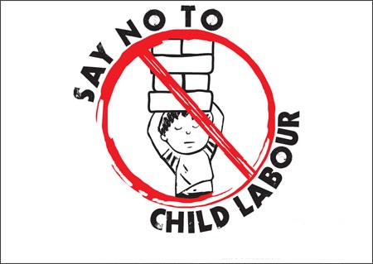
The Minimum Wages Act, 1948:
Prescribes minimum wages for all employees i n all establishments or to those working at home in certain sectors specified in the schedule of the Act. Central and State Governments can revise minimum wages specified in the schedule. Some consider this Act as an effective instrument to combat child labour in that it is being used in some States (such as Andhra Pradesh) as the basis on which to prosecute employers who are employing children and paying them lower wages.
The Right of Children to Free and Compulsory Education Act, 2009:
Provides for free and compulsory education to all children aged 6 to 14 years. This legislation also envisages that 25 per cent of seats in every private school should be allocated for children from disadvantaged groups including differently abled children.
Schemes for Children under the 10th Five Year plan include the Planning Commission's Integrated Programmed for Street Children which aims to prevent the destitution of children and engineer their withdrawal from streets by providing facilities like shelter, nutrition, health care, education, recreation and protection against abuse and exploitation. Accordingly to the Government, during the 10th Five Year Plan, over 200,000 children benefitted from this.

Slide 47
Private Institutions and NGO’s against Child Labour

Slide 48
Private Institutions and NGO’s against Child Labour
NGO’s and private institutions play a major role against child labour and we cannot undermine the huge role played by NGOs in handling child labour issues.
Among the UN organizations, UNICEF has remained instrumental in initiating several steps against child labour. UNICEF has been well supported by civil society organizations and NGOs (Non Governmental Organizations).
Several renowned and committed NGOs are working to improve the situation in this field. These NGOs, both local and international, focus on different problems concerning child labour.
Many NGOs like Bachpan Bachao Andolan, ChildFund, CARE India, Talaash Association, Child Rights and You, Global march against child labour, RIDE India, Childline etc. have been working to eradicate child labour in India.

Slide 49
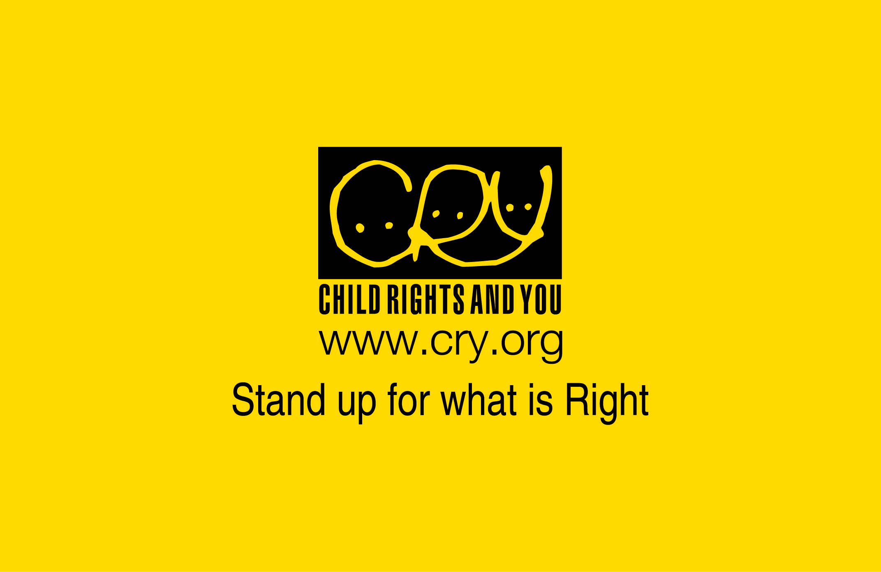


Specific NGOs focus on certain areas of improvement. For instance, if Action Aid India concentrates on child education and on street and working children then CRY(Child Rights and You) targets underprivileged children who don’t have basic resources to sustain themselves. NGOs are carrying child development activities all over India. Some children educational NGOs engage themselves in offering free education to poor kids. They teach children living in slums.

Slide 50
Quite a few NGOs focus on girls’ education. It has been witnessed that girls are made to work whereas the boy child is allowed to study but that needs to be changed. So community organizations seek to improve the quality of life of socially disadvantaged girls. With the help of health, education and social mobilization, NGOs are helping street children and in different parts of the country.
Some NGOs address issues related to lack of sensitivity and infrastructure for children’s rehabilitation, education, and reintegration. They provide basic services to the children, including formal and non-formal education. We should also contribute our bit to these NGOs through donation or by offering our services.

Slide 51
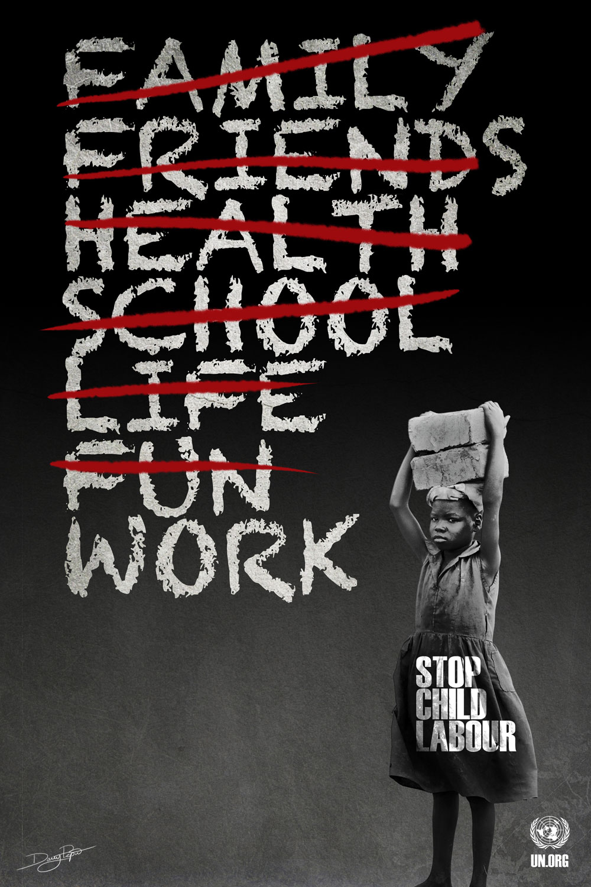
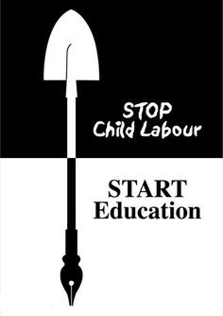

Slide 52
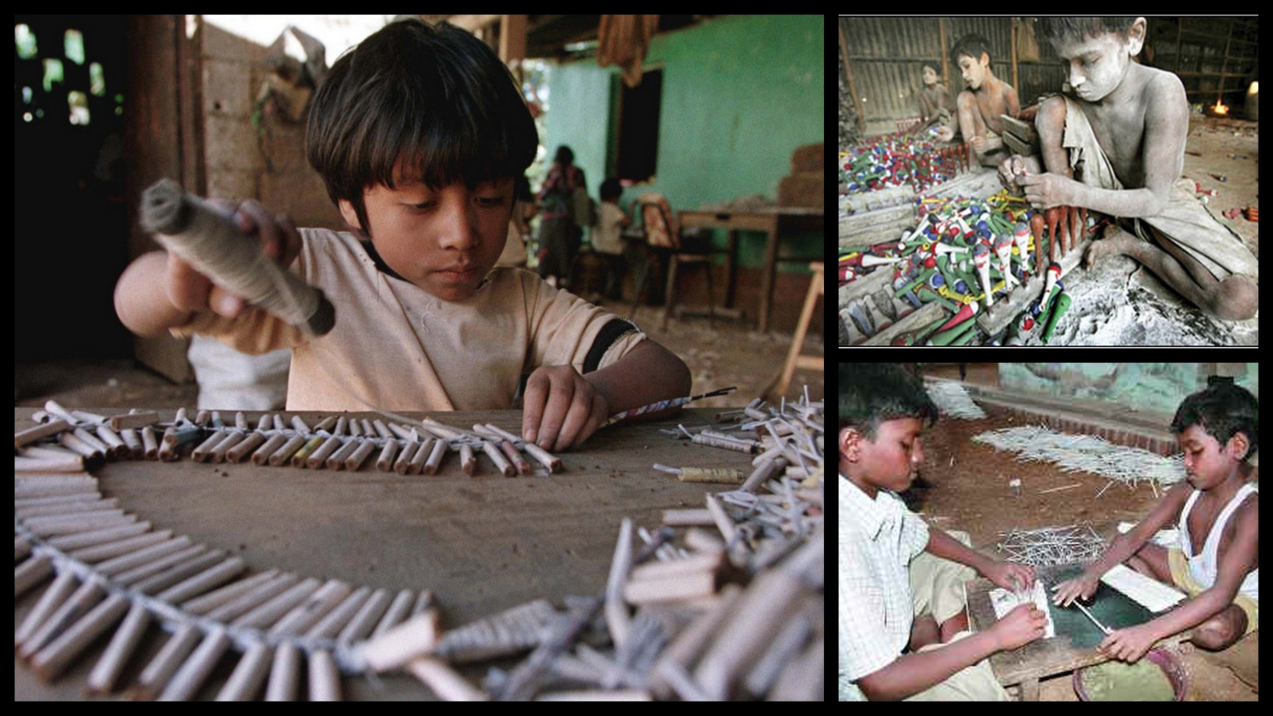
Case study on Sivakasi fireworks industry
*Think Of These Kids When Sparklers Light Up Diwali Sky*

Slide 53
CHILDREN AT FIREWORK
Sivakasi is a small municipal town in Ramanathapuram district.
It is famous for three types of industries – fireworks, match sticks and printing. 90% of India’s fireworks is produced here.
There are nearly 450 fireworks factories in Sivakasi employing almost 40,000 workers directly and about 1 lakh indirectly such as paper tube making, wire cutting, box making in the country side.
Due to lack of modern machines child labour is extensively used. Economic factor is also one of reasons responsible for child labour.
Poverty forces parents to send their children to work in these industries. Employers take advantage of their economic condition and force them to work at low wages

Slide 54
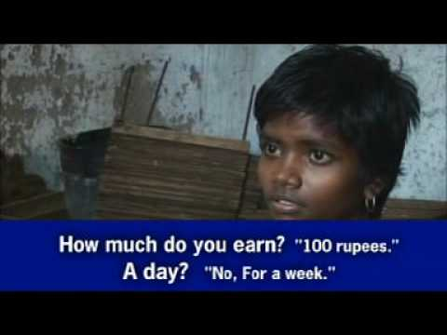
CHILDREN AT FIREWORK
According to official Harban Singh’s report which was conducted in 1976,in spite of working 12 hours a day younger children aged 4 – 10 earn an average of Rs. 2 per day.
The older ones get maximum of Rs. 6 -7 per day. According to a magazine published by The Hindu , children earn around Rs. 20-30 per day.
Talking about the working conditions, according to sources children are taken to industries like animals in buses filling almost 150-200 children in a bus. And they have to leave their house as early as 3a.m. in the morning and come back at 9p.m. at night.

Slide 55
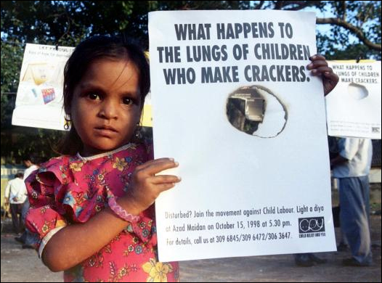
Health issues
children working in these factories suffer a lot due to the hazardous working conditions.
Also they don’t have enough time and money to spend on health issues. Filling their stomach is their prime goal.
Hence by the time they grow up they lose their health and are no longer like other normal people of their age.
Asthma and TB are prevalent among 90 per cent of them who are involved in gun powder filling and are directly in contact with the chemical ingredients of crackers and matches.

Slide 56
These workers usually do not wear any protective clothes and their whole skin can be seen covered with the chemicals such as sulphur, aluminium powder and gun powder.
“Snake Tablet” – one type of firework, which uses nitric acid, causes skin diseases. Working on this type of firework is considered to be highly dangerous for workers.

Slide 57
True facts about Child Labour

Slide 58
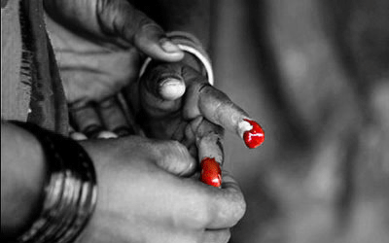
Working conditions may not be safe and healthy for children because of their physical differences.
Factors that may increase the health, safety, and developmental risk factors for children include:
Rapid skeletal growth
Development of organs and tissues
Greater risk of hearing loss
Developing ability to assess risks
Greater need for food and rest
Higher chemical absorption rates

Slide 59
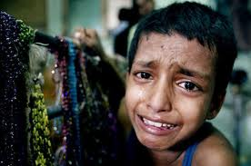
Injuries among young workers:
Active children suffer injuries or illnesses while working.
Industries have higher numbers of young workers in the India.
Psychological effects of child labour:
Long hours of work on a regular basis can harm children’s social and educational development
The unconditional worst forms of child labour may have traumatic effects.

Slide 60
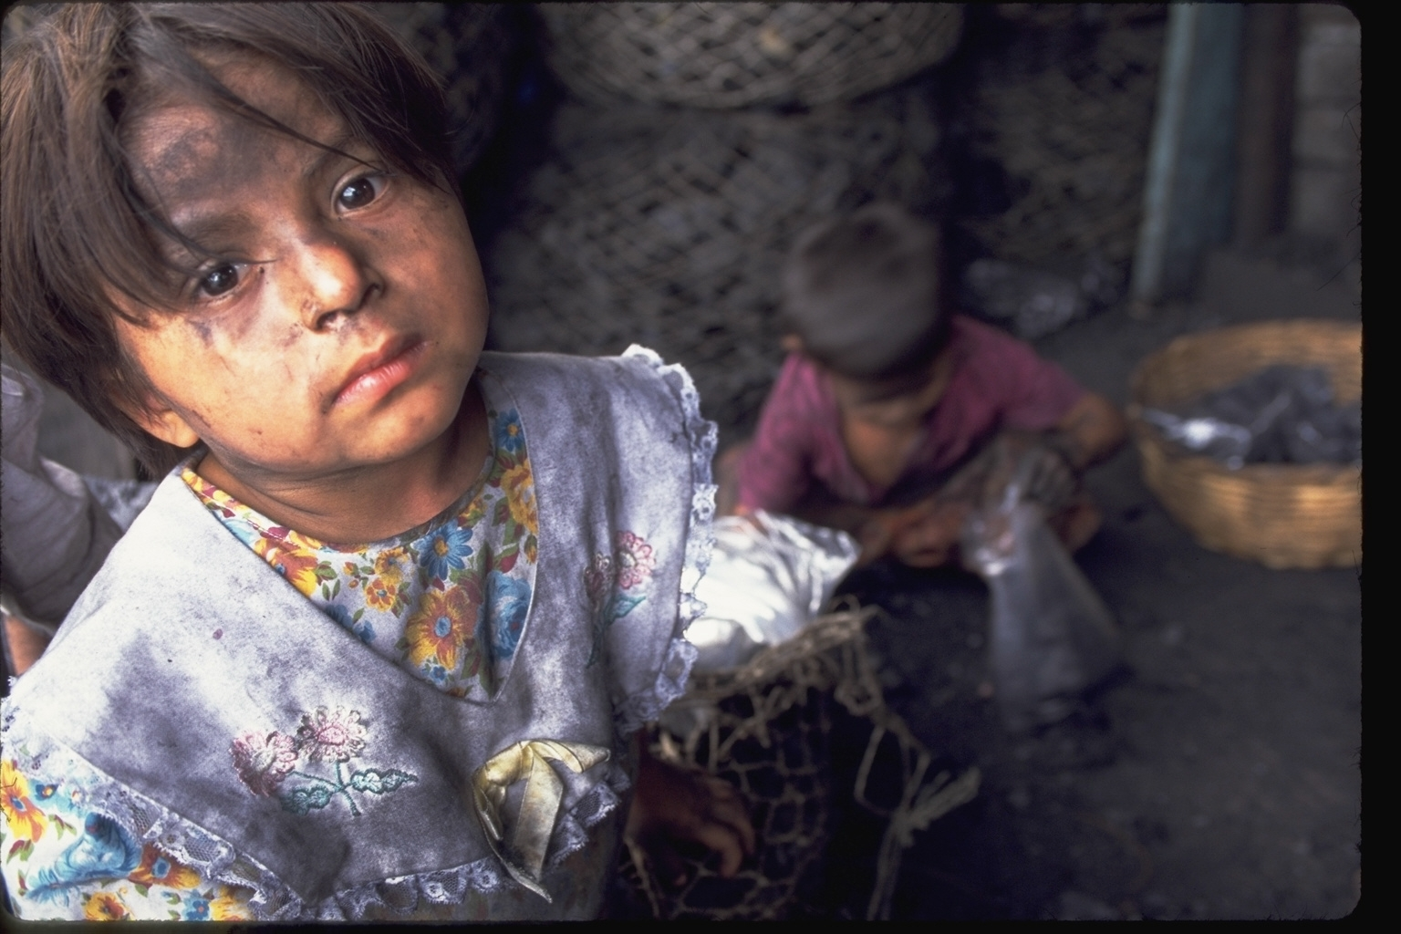

Child Abuse
one of the worst thing, but children can not do anything because they are helpless and forced due to poverty and many other factors.
Physical Abuse :
Out of 69% children physically abused 54.68% were boys
The State of Andhra Pradesh, Assam, Bihar and Delhi have consistently reported higher rates of abuse as compared to other states.
Sexual Abuse :
53.22% children reported having faced one or more forms of sexual abuse.
Emotional Abuse and Girl Child Neglect
83% of the cases parents were the abusers.
48.4% of girls wished they were boys

Slide 61
Heart –touching case
The news from Dunya TV about an eleven year old child named ‘Umme Rubab’ who is a domestic laborer and was reportedly severely beaten and tortured by a government official’s wife for only five thousand rupees per month. She was tortured repeatedly so much that her eyes were closed shut due to swelling.
What happened to Umme Rubab isn’t just a random crime that just happened to happen and was caught by the media. It has been happening for years. The Institute of social justice reported 29 child house workers’ deaths in 4 years from torture.
This is not the single case there are many more in the world

Slide 62
True fact
When we talk about abuse against child domestic workers, we don’t discuss the reasons behind such abuse. We condemn the act while the maid is ordered to bring agaram garam cup of chai. Each domestic worker employed in the house, whether a child or a good ole’ massi ji, we treat them differently.
Why?
Yes it’s obvious that we are paying them for a work but still the main reason behind that is people think that they are not belonging to their culture and society. They often call them dirty people.
Dishes can be washed, and they wash our dishes. The problem we can’t seem to get rid of is that we do not treat other people as we like ourselves to be treated. It has become a second nature , even house workers are used to it and they know the rules.
There is simple formula “would you ever treat your own child that way or would you want your child to be treated the way ‘Umme Rubab’ or other kids are treated?”
Fredrick Douglas said “It is easier to build strong children than to repair broken men.” We as a broken society are raising irreparable broken men and women and each and every one of us is guilty of this crime.

Slide 63
Effect of Child Labour on a Child
How does child labour affects a child?
Some children combine work and study but most of them cannot. In most cases work has negative effect on study.
Children can suffer negative psychological effect from verbal, sexual behaviour from employer
Works can have very harmful effects on child’s development. In worst case he/she may die.
It can help to learn important skills and pay for food and health.
Work can strengthen self esteem of child who feels that he or she is contributing for the family

Slide 64
CONCLUSION
Child labour is curse to Indian society as well as our economy
The future of the community is in the well being of its children
It is required to save children for social injustice and educational deprivation

Slide 65
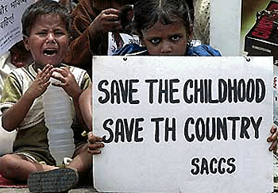
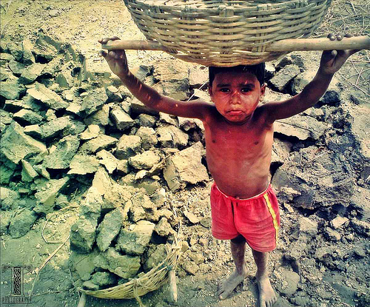
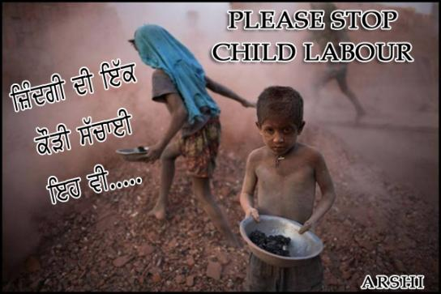
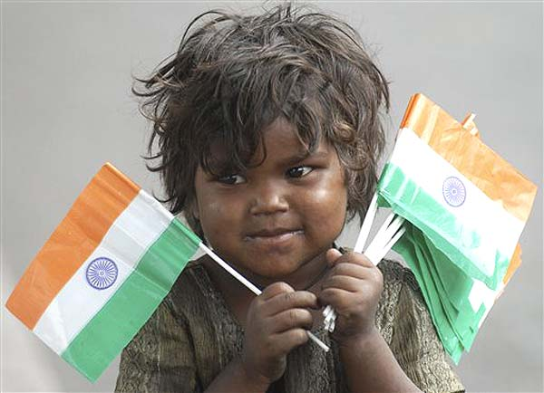

Slide 66
Group Members :
1. Maunil Vyas 1401007
2. Deep Patel 1401010
3. Shreyas Patel 1401025
4. Jay Dangar 1401043
5. Pratham Solanki 1401049
6. Ashutosh Kakadiya 1401075
7. Deep Talati 1401085
8. Harsh Mehta 1401086
9. Kishan Raval 1401117

